Slide 1
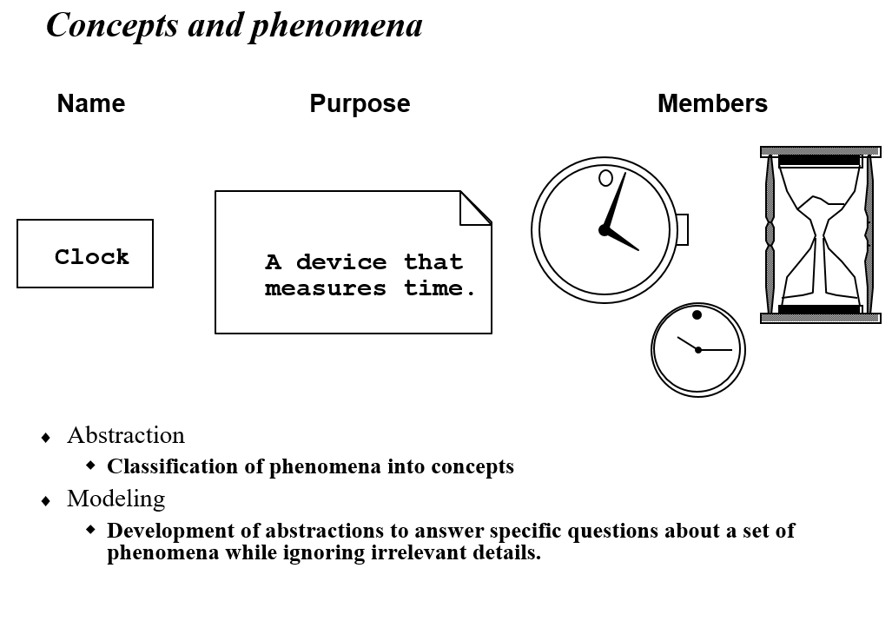

Slide 2
UML Representation of Class
Class Name
Attributes of Class
Operations/methods of Class

Slide 3
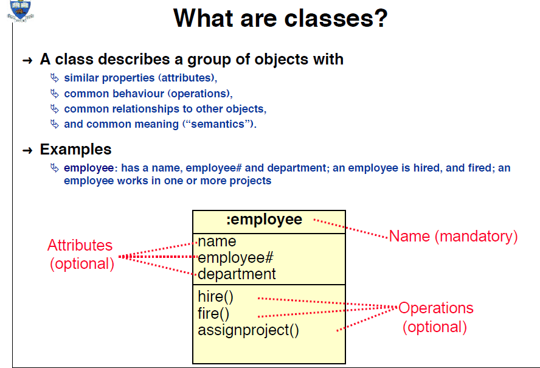
(From University of Toronto )

Slide 4
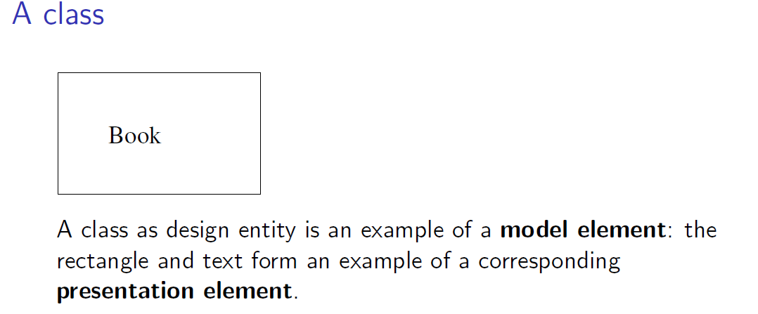

Slide 5
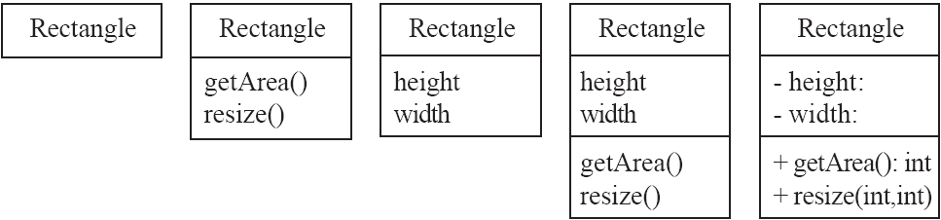
Classes
A class is simply represented as a box with the name of the class inside
The diagram may also show the attributes and operations
The complete signature of an operation is:
operationName(parameterName: parameterType …): returnType

Slide 6
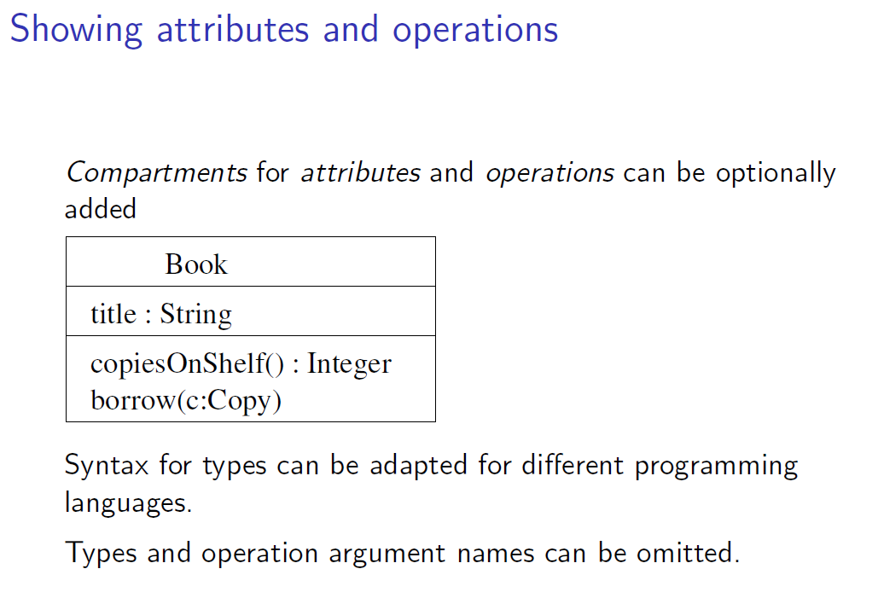

Slide 7
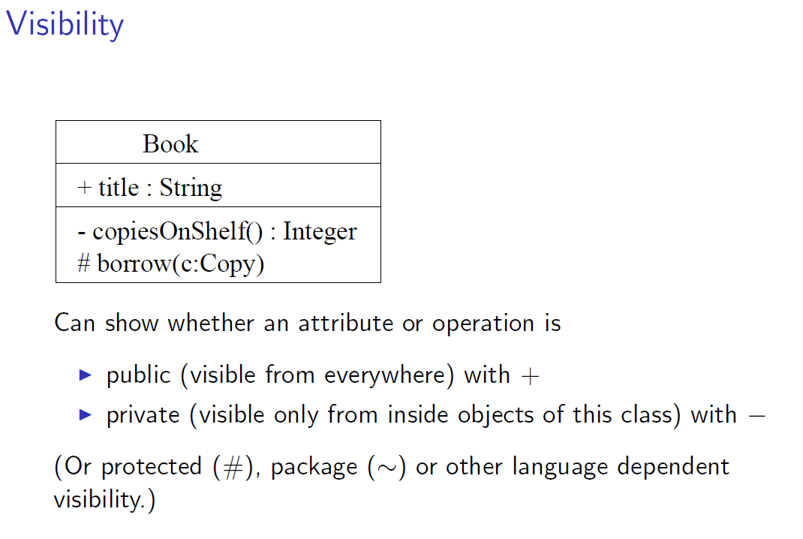

Slide 8
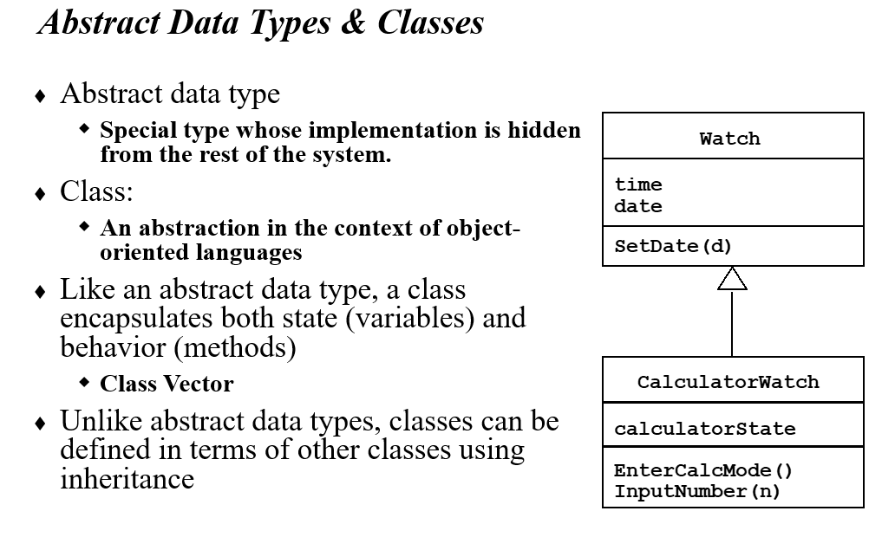

Slide 9
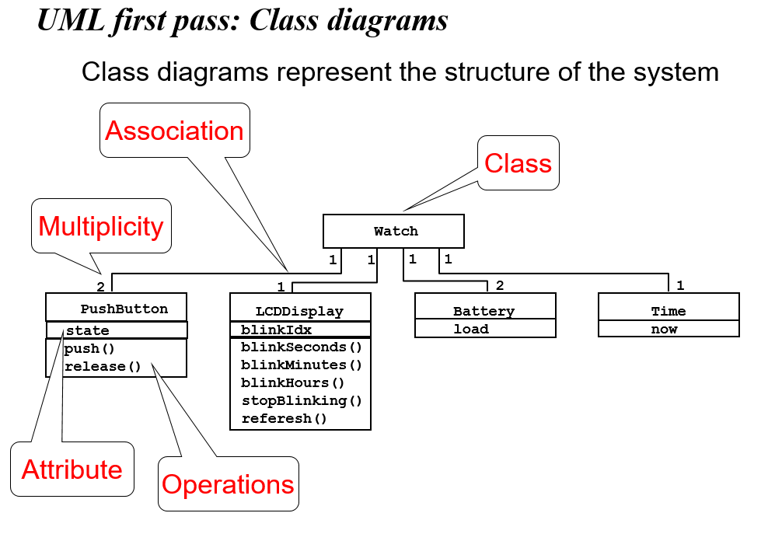
Multiplicity (Cardinality) Place multiplicity notations near the ends of an association. These symbols indicate the number of instances of one class linked to one instance of the other class. For example, one company will have one or more employees, but each employee works for just one company.

Slide 10
Attributes in a Class
Properties of the class about which we want to capture information
Represents a piece of information that is relevant to the description of the class within the application domain
Only add attributes that are primitive or atomic types

Slide 11
Operations in a Class
Represents the actions or functions that a class can perform
Describes the actions to which the instances of the class will be capable of responding
Can be classified as a constructor, query, or update operation

Slide 12
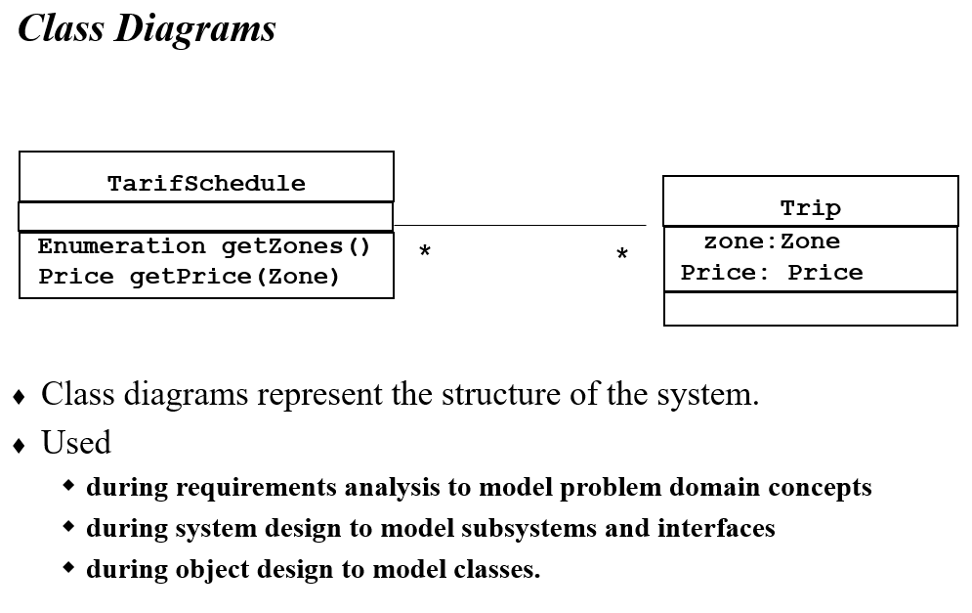

Slide 13
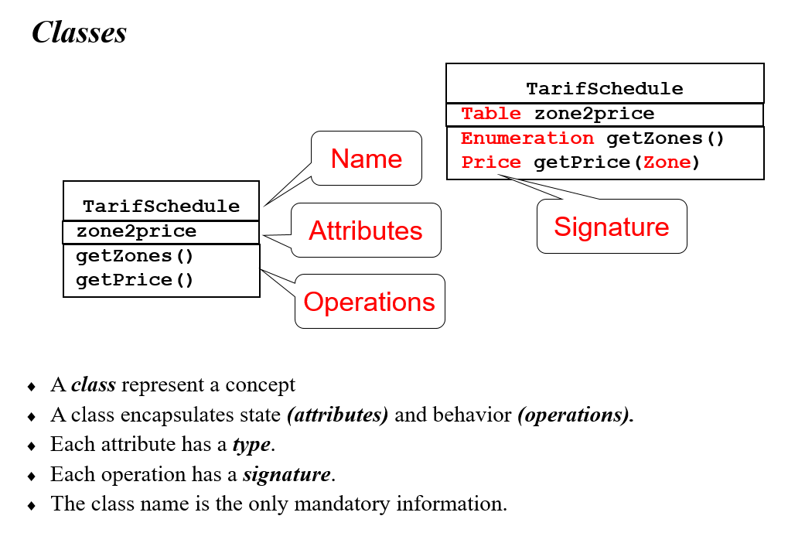

Slide 14
Relationships among Classes
Represents a connection between multiple classes or a class and itself
3 basic categories:
association relationships
generalization relationships
aggregation relationships

Slide 15
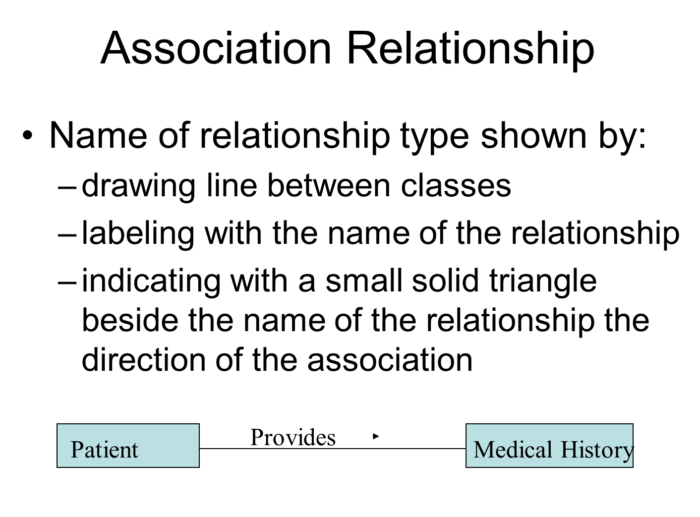

Slide 16

Association Relationship
Role type shown by:
drawing line between classes
indicating with a plus sign before the role name
https://stackoverflow.com/questions/16732607/role-name-in-association-relationship
Role: A role name explains how an object participates in the relationship. Each object needs to hold a reference to the associated object or objects. The reference is held in an attribute value within the object. When there is only one association then there is only one attribute holding a reference.
You have two classes, Professor and Book and they are associated as in the following diagram:

Slide 17

The diagram shows that Query builder has a Query (and vice versa). How is this association depicted in the code?
You have a class QueryBuilder that has an attribute of type Query named query. In code:
class QueryBuilder { Query query; }
And you have a class Query that has an attribute of type QueryBuilder named qbuilder
In code:
class Query { QueryBuilder qbuilder; }
The attribute (query for class QueryBuilder and qbuilder for class Query) is the reference to the associated object
When there is only one association then there is only one attribute holding a reference

Slide 18
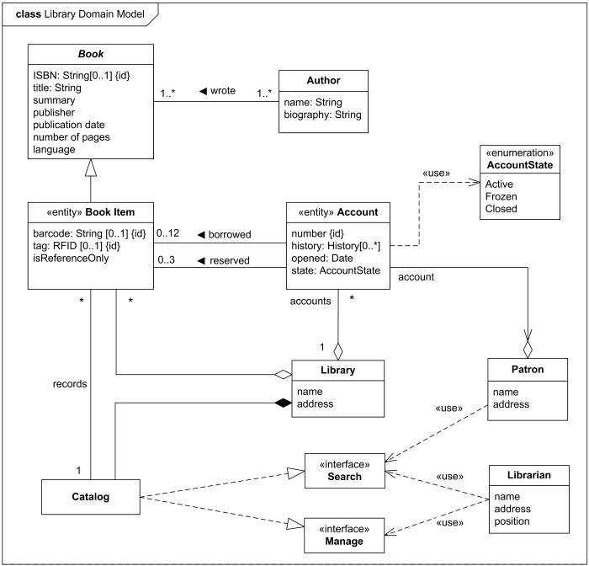
In the following diagram Acount has two associations with BookItem.

Slide 19
So, in class Account we will have two fields, one field for
each association.
class Account {
BookItem[] borrowed;
BookItem[] reserved;
}
Note that these associations are one to many, so the fields
that we have for the associations are arrays that can keep
more than one BookItems.

Slide 20
Generalization Relationship
Enables the analyst to create classes that inherit attributes and operations of other classes
Represented by a-kind-of relationship

Slide 21
Generalization Relationship
Person
Employee
Customer
Manager
Engineer

Slide 22
Generalization Relationship
Employee
hireDate
receivePay
performWork
Manager
Engineer
department
bonus
certifications
hireEmployee
promoteEmployee
analyze
design

Slide 23
https://stackoverflow.com/questions/1230889/difference-between-association-and-dependency
Association is of 2 types-
Composition
Aggregation
1) Composition- stronger Association or relationship between 2 objects. You are creating an object of a class B inside another class A (only)

Slide 24
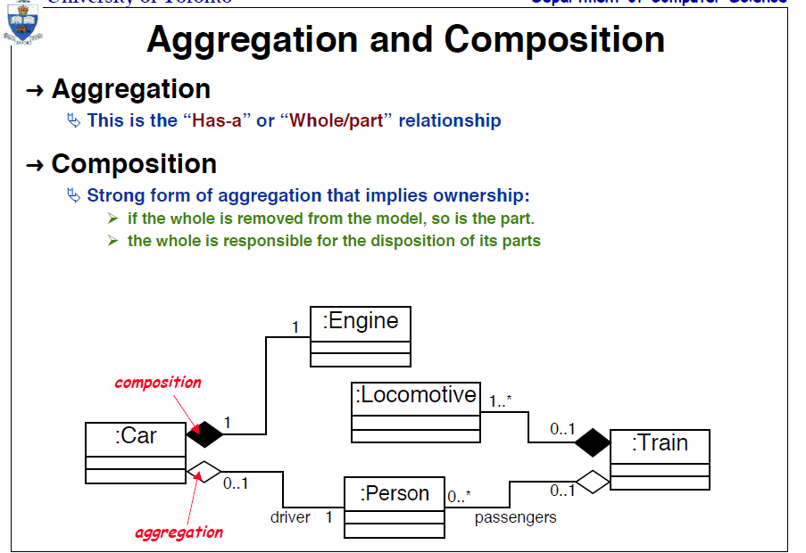
(From University of Toronto)

Slide 25
public class A {
B b;
public void setB(){
this.b= new B();
}
}
If we delete class A , B won't exist( B object is created inside A only).
Another example -Body & Liver .Liver can't exist outside Body.
2) Aggregation - weaker type of Association between 2 objects.
public class A {
B b;
public void setB(B b_ref){
this.b= b_ref;
/* object B is passed as an argument of a method */
}
}
Even if you delete class A, B will exist outside(B is created outside and passed to Class A)

Slide 26
Multiplicity
Documents how many instances of a class can be associated with one instance of another class
1
provides
0..1
Patient
Medical History

Slide 27
Multiplicity
Denotes the minimum number.. maximum number of instances
Exactly one 1
Zero or more 0..* or 0..m
One or more 1..* or 1..m
Zero or one 0..1
Specified range 2..4
Multiple, disjoint ranges 1..3, 5

Slide 28
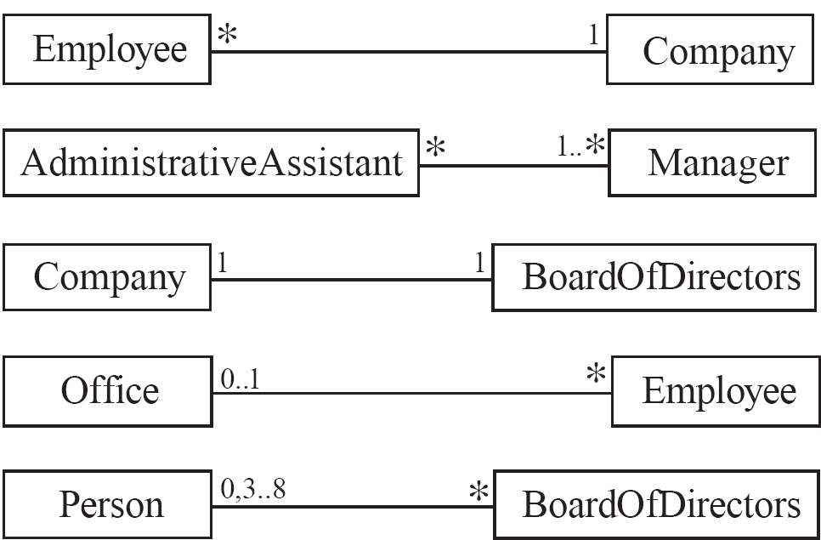
Associations and Multiplicity
An association is used to show how two classes are related to each other
Symbols indicating multiplicity are shown at each end of the association

Slide 29
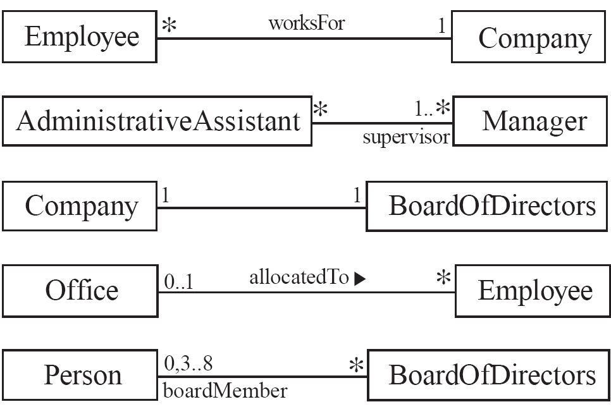
Labelling associations
Each association can be labelled, to make explicit the nature of the association

